Slide 1
Category review: Chips
June 2024
Retail Analytics
Brand note: If client logo is not required, use alternate title page layout right click slide thumbnail > Layout > Title

Slide 2
Notes:
To view Privacy video explaining how important data privacy is to Quantium, please click here: https://www.youtube.com/watch?v=Zq1QDAkoRzU
or here Q:\Company Reference\Brand & Design\Brand videos\Q Privacy.mp4
At Quantium, we believe that data is the behavioural footprint of humanity and that it has to be treated with the utmost care and responsibility.
Histories, attitudes, indeed lives are stored within it in ways that aren’t always apparent – and that’s what makes its potential so powerful.
To work with it responsibly, sensitively, we set ourselves the highest data privacy protection and governance standards.
We have spent 17 years perfecting privacy-by-design and secure-by-design principles. Central to this is not holding any personally identifiable information about people –
we neither receive it, and put the necessary protections in place to be unable to decipher it.
Every aspect of handling data is safeguarded: from its de-identification, to its encryption – data security is paramount and of the highest grade.
We pride ourselves on gaining the trust of iconic organisations around the world through years of securely working with their data,
and in turn the trust that builds with their stakeholders.

Slide 3
Executive summary
01
Task 1
The sales information of only one day is missing, 25th December, assumed the stores were closed for the Christmas celebration.
The preferred pack size by customers is the 175g pack size.
Budget-Older Families, Mainstream-Young Singles/Couples, and Mainstream-Retirees are the top contributors to chips sales.
Mainstream-Midage Singles/Couples, and Mainstream-Young Singles/Couples on average pay the most on each chips purchase transaction.
The preferred brand for most customer segments is Kettle, followed by Smiths, Doritos, and Pringles.
02
Task 2
The control stores for the trial stores (77, 86, and 88) were determined by measuring the total sales and number of customers metrics, the control stores are stores (233, 155, and 237) respectively.
Trial stores 77 and 86 demonstrated a significant increase in the total sales and number of customers for at least two of the three months during the trial period. Trial store 88 did show a notable rise in customer numbers, this increase was not observed in the total sales analysis.

Slide 4
01
Category

Slide 5
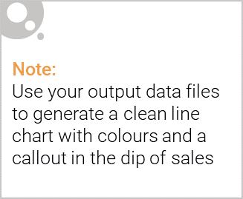
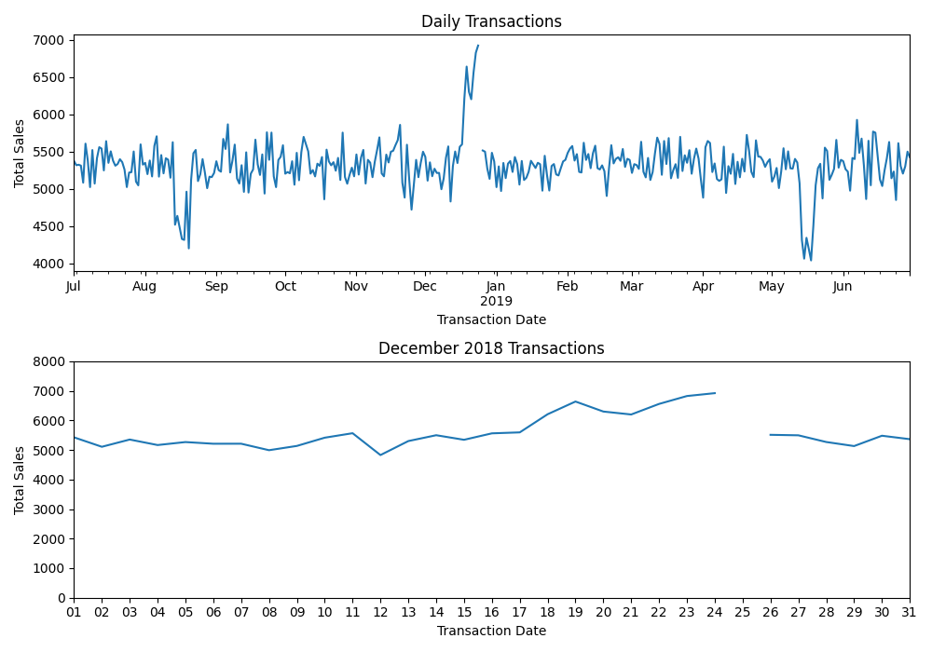
Sales increase in the month of December, most likely due to Christmas celebration. No transaction records for the 25th because stores were most likely closed for Christmas.

Slide 6
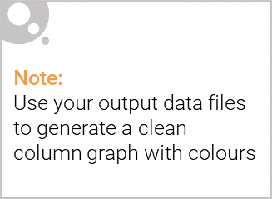
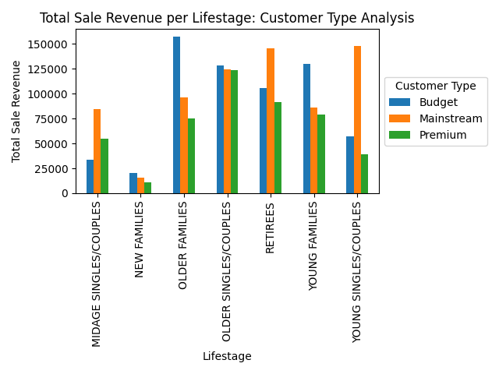
The Older Families - budget demographic contribute the most to sales, followed by the Young Singles/Couples and Retirees - mainstream demographic. This shows that premium customers do not necessarily contribute the most significant portion of sales.

Slide 7
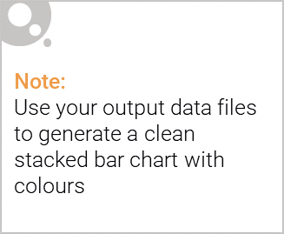
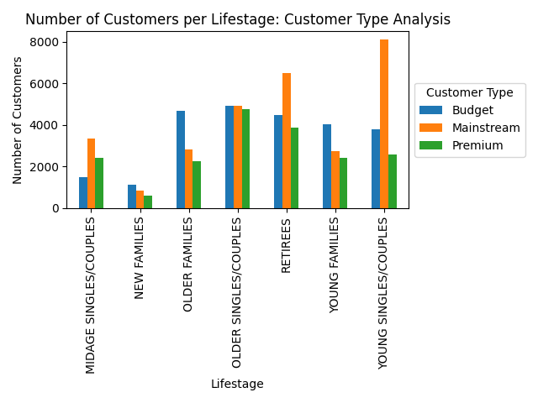
Editable (delete this)
The largest lifestage demographics are the Young Singles/Couples, Retirees, and the Older Singles/Couples. Majority of the customers within that demographic are mainstream customers, while still maintaining the largest premium customer bases.

Slide 8
02
Trial store performance

Slide 9
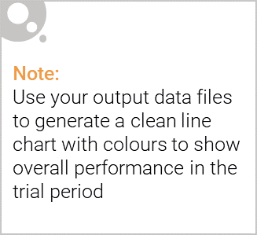
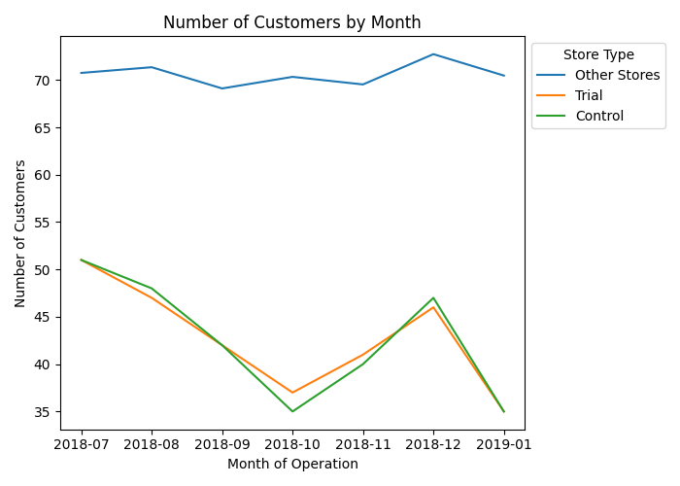
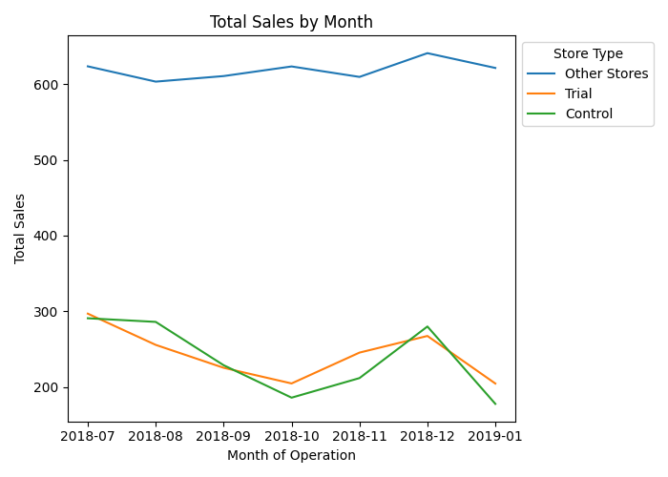
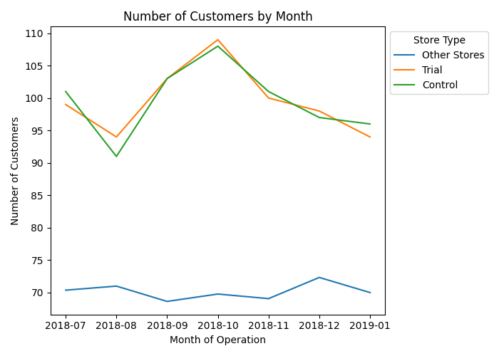
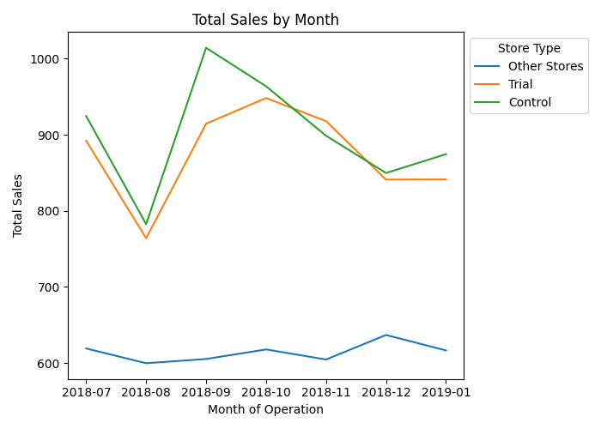
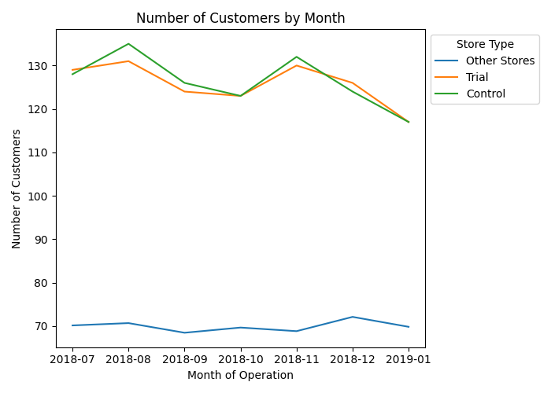
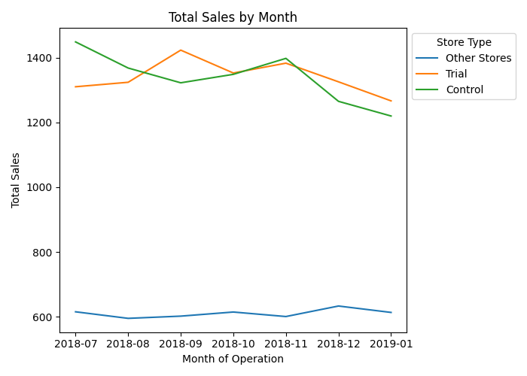
Trial Store: 77
Control Store: 233
Metrics utilising the number of customers and the total sales during the pretrial period were used to estimate the control stores, that is, stores with performances similar to that of the trial store. With this we would be able to properly account for difference in performance for the stores undergoing the trial period.
Trial Store: 86
Control Store: 155
Trial Store: 88
Control Store: 237

Slide 10
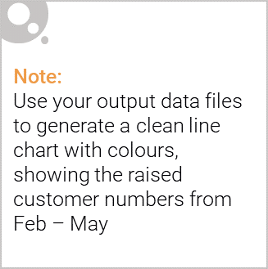
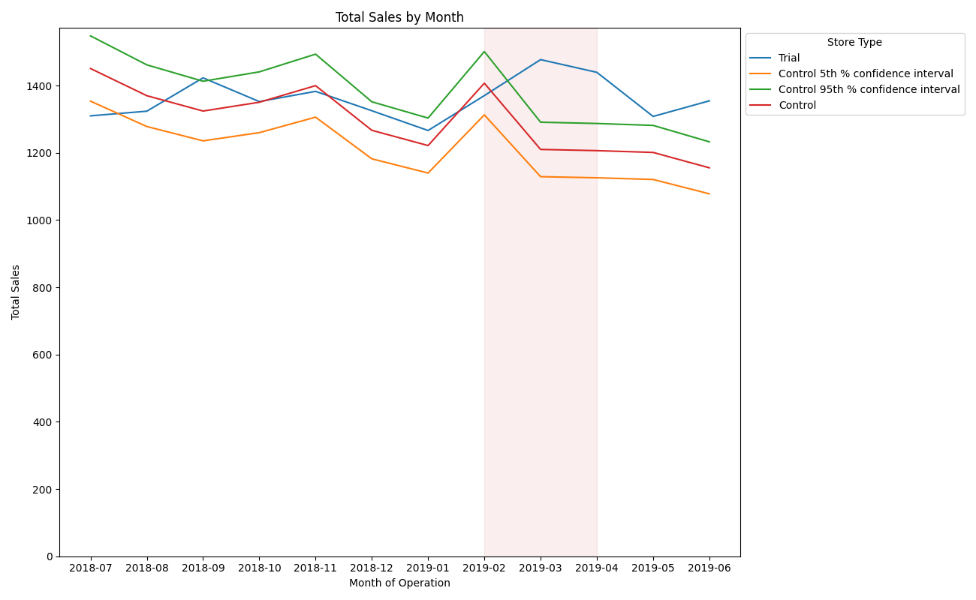
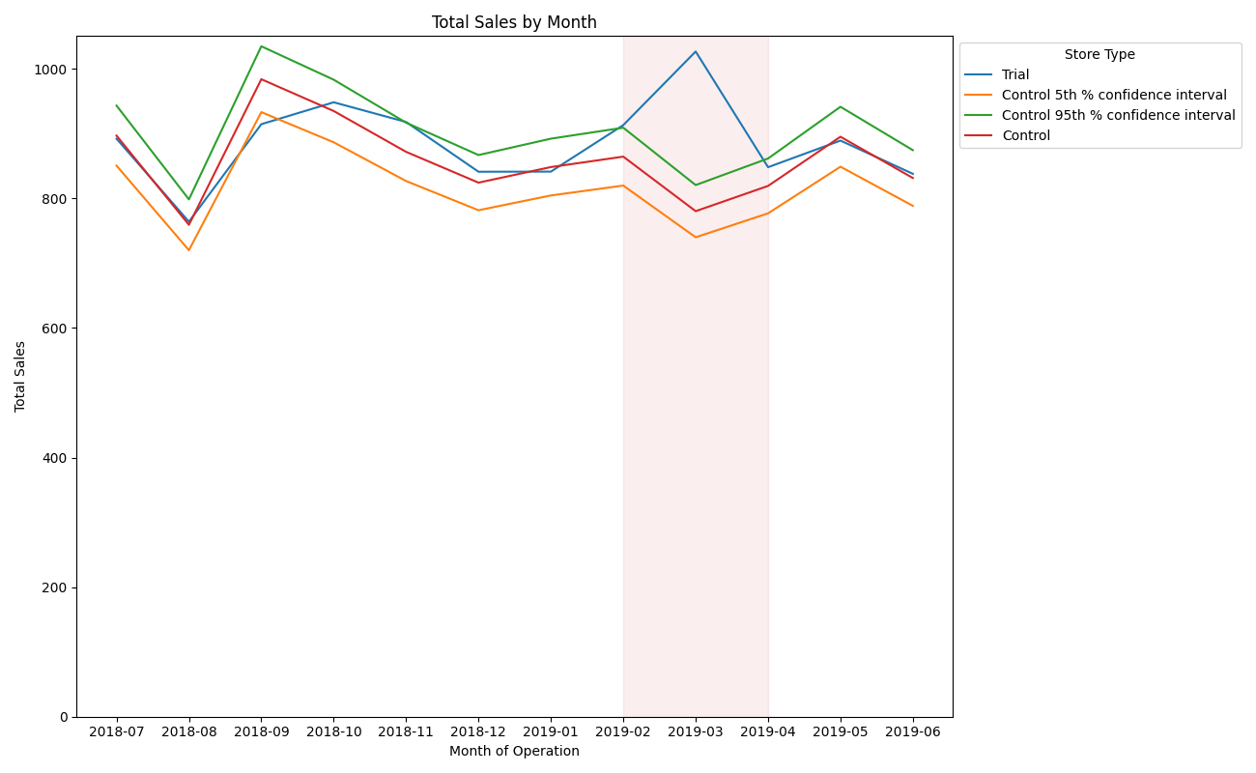
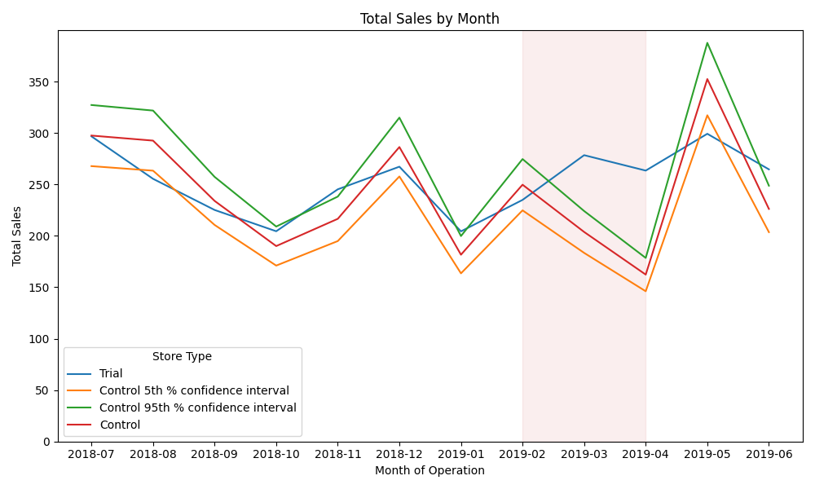
In trial stores 77 and 88, there is a significant difference in sales performance, two months out of the three trial months. However, store 86 performs significantly better sales in only one month of the three-month trial period.
Trial Store: 88
Control Store: 237
Trial Store: 86
Control Store: 155
Trial Store: 77
Control Store: 233

Slide 11
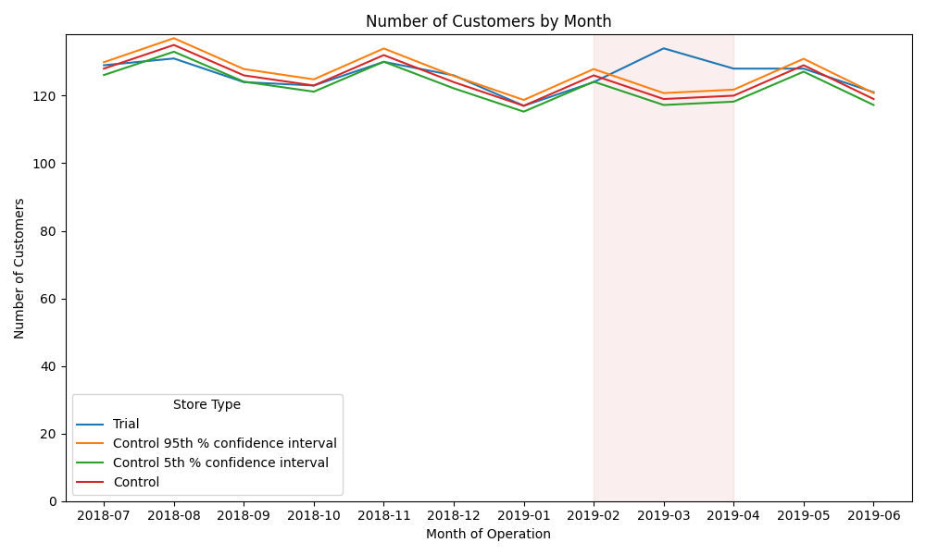
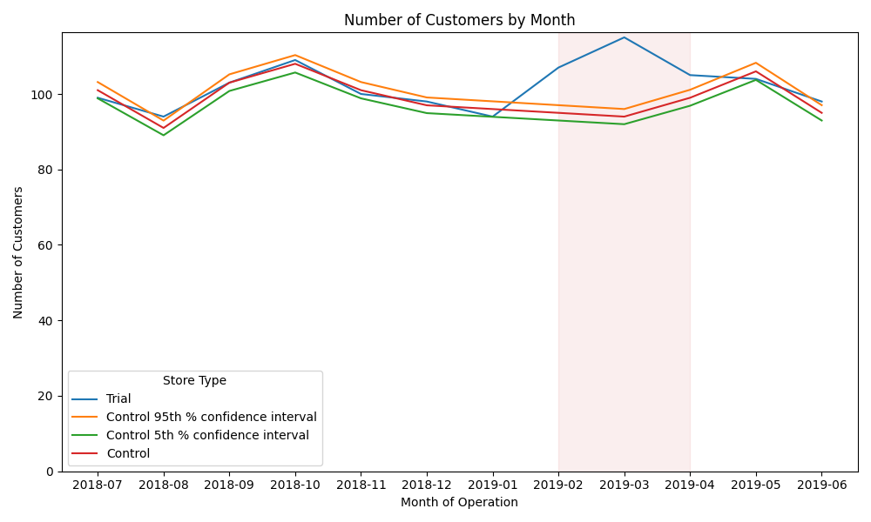
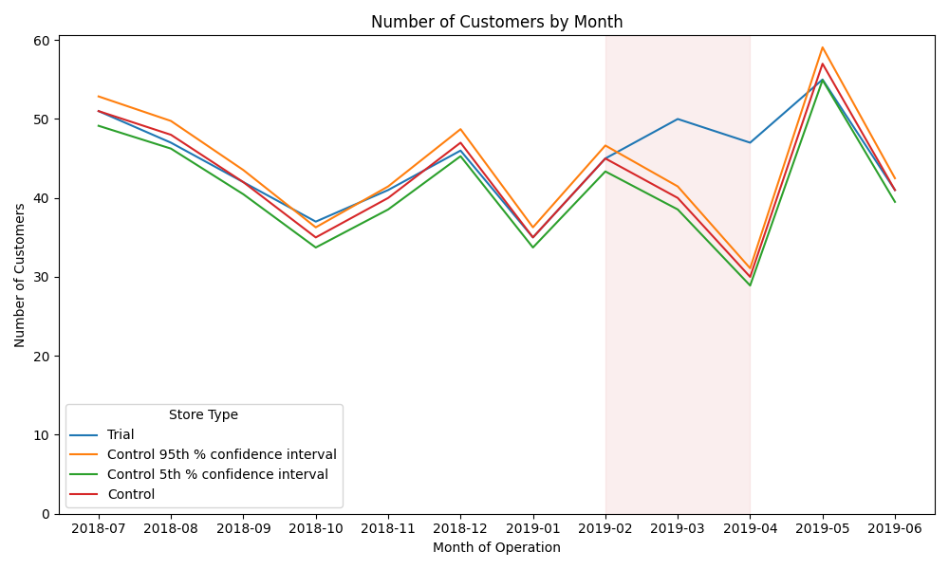
In trial stores 77 and 88, there is a significant difference in customer volumes, two months out of the three trial months. However, store 86 performs significantly better customer volume in every month for the three-month trial period, as opposed to its respective sales performance.
We need to undertake further analysis for the store to account for the possibility of discounted sales during that period.
Trial Store: 88
Control Store: 237
Trial Store: 86
Control Store: 155
Trial Store: 77
Control Store: 233

Slide 12
Recommendations
General:
- Increase stock and promotions in December.
- Boost sales promotions for Kettle (all sizes) and 175g chips (all brands).
Target Segments:
Budget - Older Families:
- Implement promotions like "Buy Two Get One Free."
Mainstream - Young Singles/Couples:
- Focus advertisements.
- Modify display areas.
- Promote and repackage popular brands and sizes.
Mainstream - Retirees:
- Focus advertisements.
- Offer limited-time sales promotions during the daytime.

